Slide 1
Disruption Tolerant Networking
SPINDLE Project: Phase 1 Accomplishments
Rajesh Krishnan
krash@bbn.com
On behalf of the SPINDLE project team:
BBN: Rajesh Krishnan, Stephen Polit, Ram Ramanathan, Prithwish Basu, David Montana,
Vikas Kawadia, Joanne Mikkelson, Regina Rosales Hain, Matthew Condell, Talib Hussain, Mitch Tasman, Partha Pal, and Daria Antonova
UMR: Prof. Don Wunsch, Prof. Larry Pyeatt, Tae-hyung Kim
Presented at the DTNRG Meeting at Dallas, TX
March 23, 2006
This work is supported by the DARPA Advanced Technology Office under the DTN program.
© 2006 BBNT Solutions LLC

Slide 2
Outline
SPINDLE System and Evaluation Platform Overview
Evaluation Scenario and Metrics
SPINDLE Performance in Evaluation Scenario
Routing Algorithms and Comparison
Advanced DTN Capabilities in SPINDLE
Lessons Learned, Future Work, and Summary

Slide 3
SPINDLE System Software
DTN prototype system
  uses DTN2 software from DTNRG with BBN modifications
    March 2005 snapshot chosen to meet schedule
Integrated Knowledge Base (KB)
  based on Flora-2/XSB deductive database
Several DTN routing algorithms implemented in KB
Neighbor discovery
  emulated discovery for performance evaluation
  real beacon-based discovery in demonstration system
Notes:
emulated discovery for performance evaluation
dtnd informed via command prompt using Tcl/expect scripting
real beacon-based discovery program in system demonstration
external module eases future migration to composable system

Slide 4
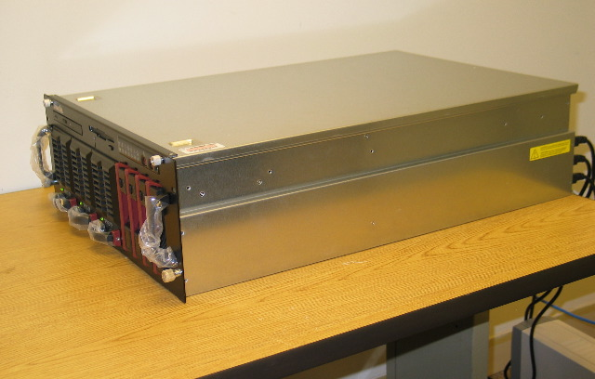
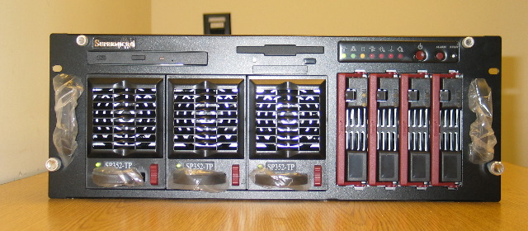
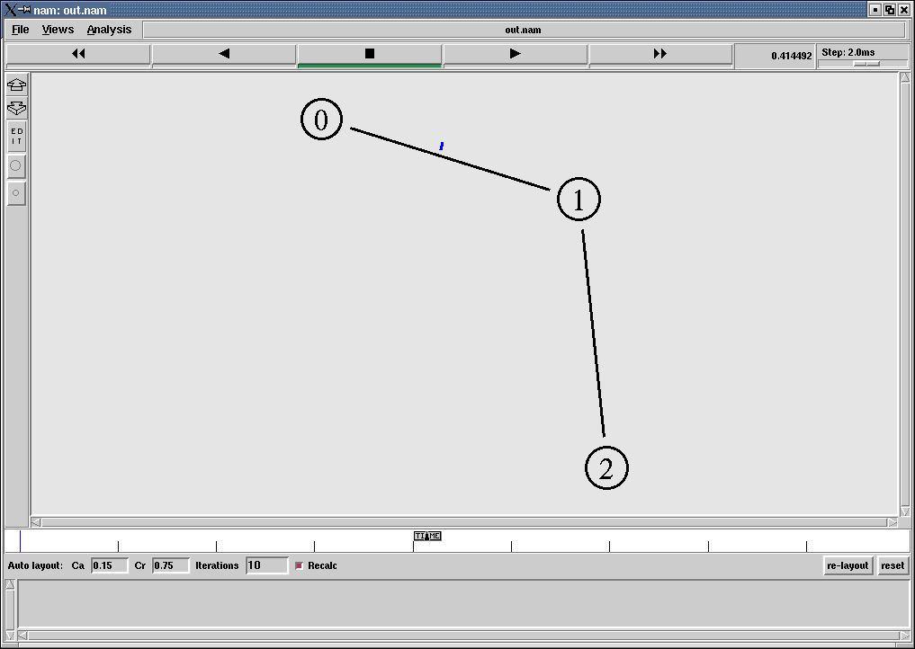
Evaluation Platform
Approach: Combines OS Virtualization and Emulation
Multiple real DTN system instances on single machine
Connect to emulated network via virtual Ethernet bridge
Flexible scripting of DTN scenarios and traffic, repeatable
Host OS (Linux)
Emulation Script
Set up
nodes
link properties
mobility models
traffic agents
routing
link schedules
User Mode Linux 1
User Mode Linux 2
User Mode Linux 3
dtnd1
dtnd2
dtnd3
Emulation Manager (modified ns-2)
manage interactions with user-mode linux
  start processes, access interfaces, access dtnd CLI
  ethernet addresses to ns2 node ids
copy link layer packet to appropriate interface
  after simulated loss/delay and error through network
Machine specifications
  4 Intel Xeon MP CPU, 2.7GHz, 2MB cache
  8GB RAM
  300GB SCA SCSI drive
  Integrated 10/100 NIC
  6 PCI-X slots
  16 DIMM Slots (32GB max)
Analysis
Trace
Visualization (nam)

Slide 5
Evaluation Platform
Key Benefits and Limitations
Required significant effort to build
Powerful, flexible environment
  can be readily replicated; scripts automate hard tasks
  supports ongoing DTN system development, test, and evaluation
  developers can have their own copy of a virtual testbed
    easier to manage than a multi-node setup
  short learning curve: Linux, ns-2
  coarse-grained simulations possible within same framework
  can be used for other projects with minor additional effort
Limitations
  needs a powerful machine with a lot of memory
  needs host kernel modification
  emulator is a single process, which limits total event throughput
  inherits ns-2 limitations for modeling wireless networks
  care must be exercised with expect scripting after emulation starts
  network is isolated, i.e., all cross traffic must be emulated

Slide 6
Outline
SPINDLE System and Evaluation Platform Overview
Evaluation Scenario and Metrics
SPINDLE Performance in Evaluation Scenario
Routing Algorithms and Comparison
Advanced DTN Capabilities in SPINDLE
Lessons Learned, Future Work, and Summary

Slide 7
Evaluation Scenario
Topology: 5-X-4 grid
Link characteristics
  capacity: 19.2 kb/s
  delay: 5 ms
  MTU: 1480 bytes
  bi-directional
Bundle traffic
  size: 2800 bytes
  per origin-dest. pair: 2
  total originated: 264
  origin-dest. distance
  (Manhattan metric): 4-7
  originated before links are up
Run time: 3600 s
Convergence layer: TCP
Link dynamics (1): random
  epoch (OFF + ON)
  chosen uniformly in: [60:600] s
  availability targets γ: {0.07, 0.1, 0.15,
  0.2, 0.3, 0.4,
  0.5, 0.8, 1.0}
  availability in epoch
  chosen uniformly in: [γ-.05:γ+.05]
  all links down at start
  independent identical distribution
Link dynamics (2): adversarial
  four link patterns at 90° phase offsets

Slide 8
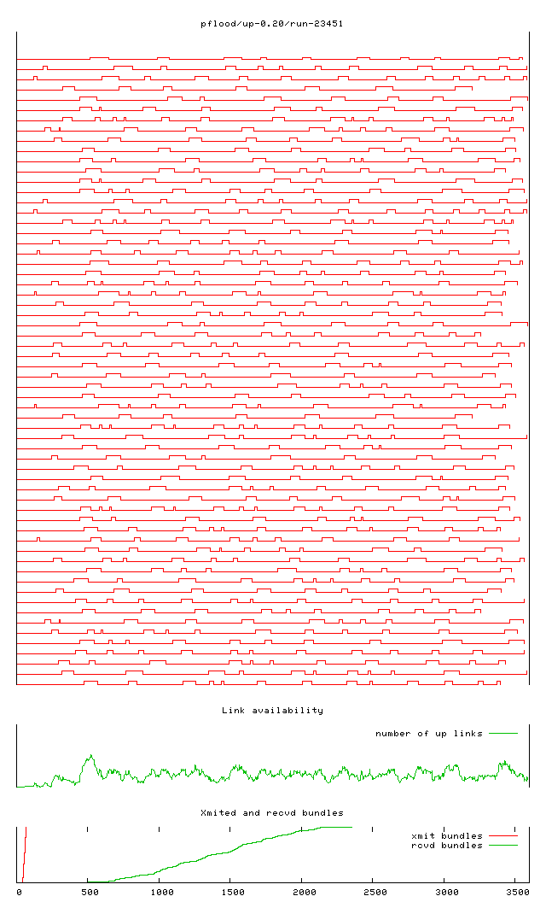
Random Link Dynamics Versus Time
Visualization of a Run at 20% Availability
A link state update requires > 4.3s to travel across the 7-hop network diameter (we need > 620ms to forward a 1480B packet one hop at 19.2kb/s). A link up/down occurs somewhere in this network nearly every 5s. Thus these dynamics are highly disruptive to traditional link state dissemination.
At most 16 (out of 31) bi-directional links were up at any time

Slide 9
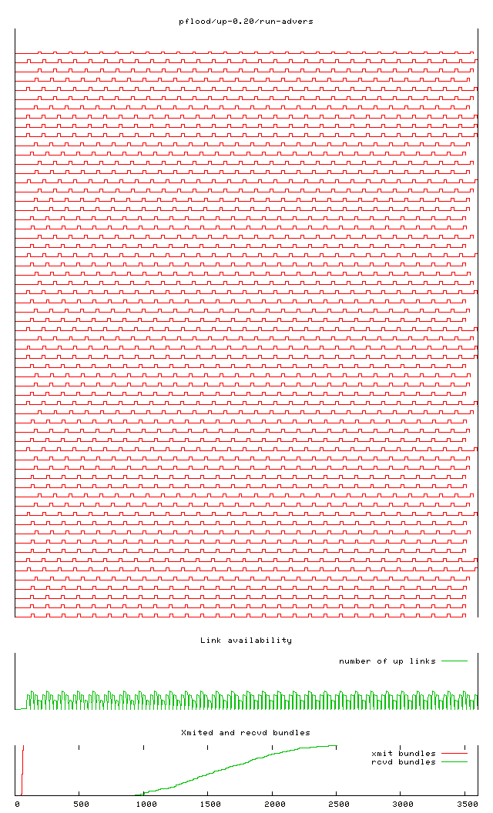
Adversarial Link Dynamics Vs. Time
Visualization of a Run at 20% Availability
Random link dynamics – although disruptive – admit some long paths. The adversarial link dynamics (below), based on four periodic patterns at 90° phase offsets, is more challenging. It admits no paths >1-hop below 25% availability, no paths >2-hops below 50%, and no paths >5-hops below 75%.
0
2
0
2
0
3
3
3
3
3
0
2
0
2
1
1
1
1
1
1
0
2
0
2
2
3
3
3
3
3
0
2
0
2
3
At most 10 (out of 31) bi-directional links were up at any time

Slide 10
Metrics
Target: 100% Delivery, 80% Utilization, 20% Availability
Delivery ratio
  fraction of originated bundles (from all sources) delivered to their destinations during the run
Average link availability
  fraction of the time during
  the run that links are up, averaged over all links
Link utilization
  ratio of
    data transmitted on a link within a communication opportunity (bits)
  TO
    the maximum possible, i.e., product of the link capacity (bits/s) and the opportunity duration (s)
  we report
    peak (maximum) link utilization across all opportunities and links
    average link utilization averaged over all links and opportunities when there was data to send
Completion time
  total time to deliver (at least
  one copy of) all bundles to
  their destinations
Message count
  number of bundles (data and control, if any) forwarded in the entire network during the run

Slide 11
Baseline
Baseline for comparing DTN performance
  end-to-end TCP connections
  idealized link state routing in underlay
    zero control overhead, instantaneous convergence
      shortest paths recomputed globally in emulator on each link event
      practical link state approaches unlikely to realize this performance
    lack of extraneous traffic in baseline allows fair comparison
Other parameters are kept identical for DTN and baseline
  identical application software / overhead
  identical traffic load, topology, and link dynamics
All metrics reported are from real system measurement
  extracted from dtnd logs and live packet traces from emulator
  the confirmation required 54 hours of experiment data

Slide 12
Outline
SPINDLE System and Evaluation Platform Overview
Evaluation Scenario and Metrics
SPINDLE Performance in Evaluation Scenario
Routing Algorithms and Comparison
Advanced DTN Capabilities in SPINDLE
Lessons Learned, Future Work, and Summary

Slide 13
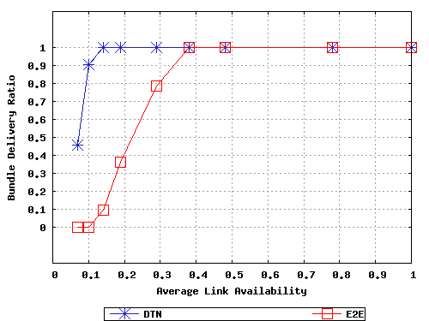
Delivery Ratio: Random Dynamics
DTN versus End-to-End (E2E) Baseline
Offered Load:
264 bundles,
2800 bytes each
Run Duration:
3600s
criterion met
for reliable delivery
Dynamics admits several four and five hop paths

Slide 14
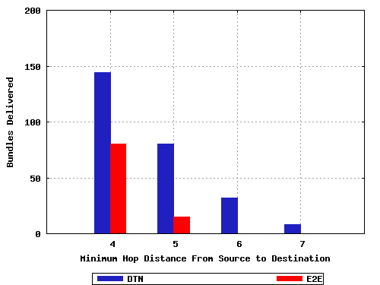
Delivered Bundles Vs. Path Distance
Run at 20% Target Availability: Random Link Dynamics
Every node was allowed to source or sink traffic.
Bulk of the offered load
was from 4-hop and 5-hop
traffic. The baseline case
is not challenged by this
load since the random
link dynamics admits such
paths.
Note however that baseline
performance would have dropped significantly if the offered load did not include any 4-hop traffic.
100%
55.55%
100%
100%
18.75%
100%
0%
0%

Slide 15
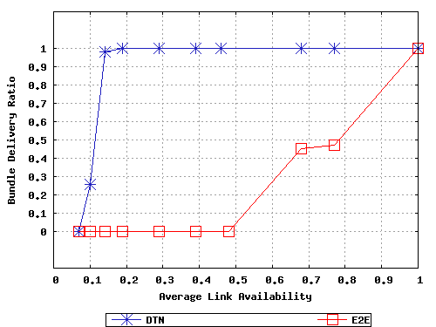
Delivery Ratio: Adversarial Dynamics
DTN versus End-to-End (E2E) Baseline
Offered Load:
264 bundles,
2800 bytes each
Run Duration:
3600s
criterion met
for reliable delivery

Slide 16
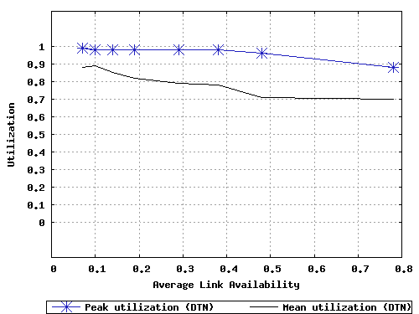
Link Utilization Using DTN
Peak and Average
Offered Load:
264 bundles,
2800 bytes each
Run Duration:
3600s
criterion met
for utilization
Link Dynamics: Random

Slide 17
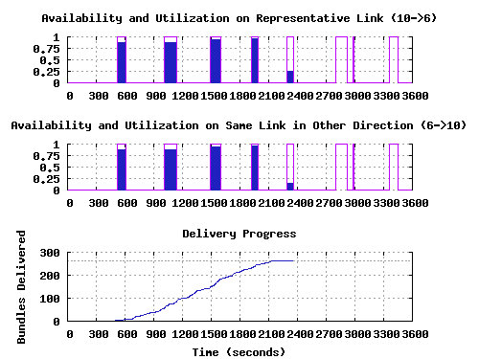
Delivery and Utilization Versus Time
Close-up View of a Run at 20% Target Availability

Slide 18
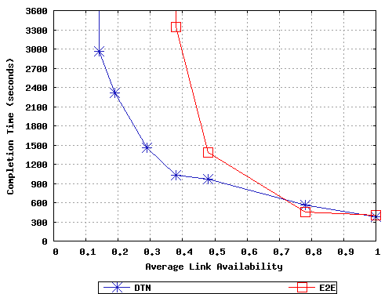
Completion Time Versus Availability
Workload Completes Faster At Higher Availability
Offered Load:
264 bundles,
2800 bytes each
Run Duration:
3600s
At 20% availability,
DTN delivers all the
bundles at 2400s,
but baseline has not
completed delivery
even at 3600s

Slide 19
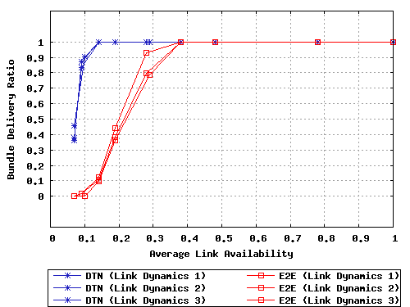
Varying Link Dynamics Patterns
DTN Performance Consistent Across Runs
The baseline case performs better with some link dynamics than with others due to the random occurrence of longer end-to-end paths; adversarial link dynamics that admits fewer end-to end paths will affect the baseline case severely

Slide 20
Outline
SPINDLE System and Evaluation Platform Overview
Evaluation Scenario and Metrics
SPINDLE Performance in Evaluation Scenario
Routing Algorithms and Comparison
Advanced DTN Capabilities in SPINDLE
Lessons Learned, Future Work, and Summary

Slide 21
Algorithms Currently Implemented
Several algorithms are implemented in KB
  PFLOOD, a pure flooding approach
  REPLIF, a replica forwarding approach with staggered attempts
  RANDWALK, a random walk based approach
  QUIKROUTE, a link state approach enhanced for DTN
    supports discovered, scheduled, and predicted link availability
  HYBRIQ, a hybrid approach using QUIKROUTE and RANDWALK
Choice of strategy declared via dtnd command
Many other algorithms and variants are possible
  experimentation limited by schedule constraints

Slide 22
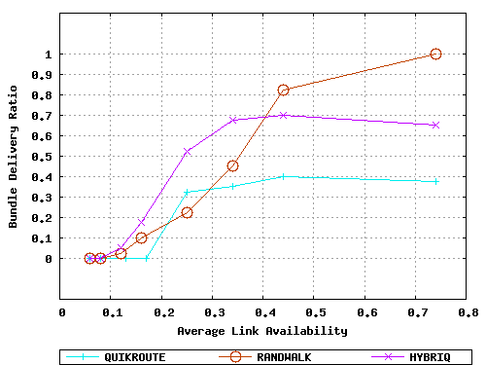
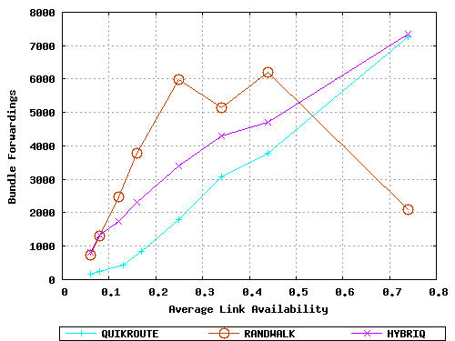
Delivery Ratio and Message Count
Comparison of Different Routing Algorithms
Offered load: 40 bundles of 2800 bytes; Time:1200s; Source-Destination path: 6-7 hops
In case of dissemination based strategies, LS updates are sent every 30s
Delivery Ratio
Bundle Forwardings
A crossover point
Zero knowledge strategy
consumes a lot of resources
Hybrid performs
better than pure
strategies
Hybrid performs worse
than zero knowledge
strategy because of
high update rate
Non-adaptive dissemination does not scale due to high update rate
Adaptive dissemination will help us track these curves

Slide 23
Outline
SPINDLE System and Evaluation Platform Overview
Evaluation Scenario and Metrics
SPINDLE Performance in Evaluation Scenario
Routing Algorithms and Comparison
Advanced DTN Capabilities in SPINDLE
Lessons Learned, Future Work, and Summary

Slide 24
Declarative Paradigm in SPINDLE
We have a unique declarative approach based on Deductive Databases
  declare facts and rules in KB implemented in Flora-2/XSB
  connectivity, naming, and bundle metadata information stored as facts
  routing, forwarding and link scheduling performed by execution of rules
  facilitates decision making and search in a rich space of dynamic facts/rules
  flexible and extensible framework
Using the declarative paradigm, we have prototyped DTN algorithms
  routing: random walk, replicated forwarding, link state, hybrid
  policy: routing, forwarding, bundle scheduling, discard, …
  late binding: dynamic intentional name resolution
Notes:
Extensible: (1) Flora-2 is object oriented: has support for inheritance (classes)
(2) One can add new rules into KB

Slide 25
Why deductive databases?
Derivation of facts from simpler facts and specified rules
  Facts: Adj [from -> “n1”, to -> “n2" ].
  Rules:
  Path[src->S,dst->D] :- Adj[from->S,to->D] ; Path[src->S,dst->Z], Path[src->Z,dst->D].
Uniform query interface for both simple and derived facts
  explicit: Adj [from -> “n1”, to -> “n2”, upAt -> “12:01:00”].
  expression: Adj [from -> “n1”, to -> “n2”, upAt -> U] :- U is when_UAV_overhead.
  query (in both cases): Adj [from -> F, to -> T, upAt -> U].
Rapid prototyping of DTN protocols without compiling C/C++ code
Easier to tie-in policy, mission specifics, and logistics with networking
Intelligent network management plane: supports complex queries
Notes:
If some interval calculus rules are added, then we can answer questions like: will there be a path between S and D between T1 and T2?

Slide 26
SPINDLE KB based on Flora-2/XSB
FLORA-2 = F-LOgic tRAnslator
  Declarative, object-oriented, (first order) logic programming style
  Logic based knowledge representation with frames (F-logic), meta (HiLog), and side-effects (Transactional logic)
FLORA-2 is built on top of a tabled Prolog engine (XSB)
  XSB beneficial over some prologs because it solves the termination problem
FLORA-2 has greater usability than Prolog
  Useful OO features such as inheritance
  Advanced aggregate expression support (better than SQL)
  Good interfaces (C and ODBC) and persistence features
Notes:
XSB solves the termination problem of other prologs

Slide 27
Sampling of SPINDLE KB ontologies
(in Flora-2)
Frame Declaration for Bundle metadata
Frame Declaration for Adjacency metadata
bundle [
source => string,
dest => string,
size => integer,
creationTs => float,
expiration => float,
custodian => string,
priority => integer,
.
.
.
bid => integer,
adjsConsidered =>> string,
nbrFlooded =>> string,
blobKey => string
].
spindleAdjacency [
fromNode => string,
toNode => string,
adjName => string,
adjUpAt => integer,
adjDownAt => integer,
adjDelay => integer,
adjCapacity => integer,
.
.
.
creationTs => integer,
modTs => integer,
clType => string,
clAddr => string,
clIface => string,
adjType => integer
].
from
DTN bundle
specification
local
metadata
could be bound
by late binding
module

Slide 28
Specifying More Complex Adjacencies
t = T1
t = T2
Uav
t = Tnow
Ground node X can form a Predicted Adjacency with some Uav node at t=Tnow if trajectory information is known beforehand
X
KB allows a succinct expression of a rule to deduce a predicted adjacency
predictedAdjacency :: spindleAdjacency.
S : predictedAdjacency [fromNode -> X, toNode -> Uav , adjType -> “PREDICTED”,
adjUpAt -> T1, adjDownAt -> T2 ] :- walltime (Tnow),
Uav [ trajectory -> Trj1], X [ trajectory -> Trj2 ],
trajectory_xing ( Tnow, Trj1, Trj2, [ T1, T2 ] ), !.
Such information can be disseminated and used for routing decisions

Slide 29
Predicates for DTN Routing
Decision Points Exported to Declarative Engine
Compute single source routes according to a given routing strategy
#calcRoutes ( ThisNod, RouteStrat, AdjKB ) :- …
Determine next hop for bundle according to a given routing strategy
#getNextHop ( Bid, ThisNod, NextHop, RouteStrat, AdjKB, BundleKB ) :- …
Determine the best adjacency for forwarding to the next hop neighbor
#getBestAdjacency ( ThisNod, NextHop, Adj, FwdStrat, AdjKB ) :- …
(some fields of Adj could be late bound by the above predicate)
Determine which pending bundle needs to be scheduled for transmission according to a given recirculation strategy
#getBundlesDue ( ThisNod, Bid, RecircStrat, AdjKB, BundleKB ) :- …
Notes:
# in front of predicates indicates “no tabling” or caching
! aka ‘the cut’ means end the resolution process and return as soon as the first match occurs

Slide 30
Policy Based Resource Utilization
We have just restarted work on this task
  leverage experience from XG and previous policy work
Policy can be used to govern a multitude of resource constraints depending on network dynamics and mission needs
  which strategy to use for the following decisions
    routing, forwarding, recirculation, and discarding
  adjacency formation/usage taking into account costs
    e.g., try in order - static, discovered, scheduled, on-demand, predictive
  bounds on storage with respect to expiration, custody, and deletion
  which convergence layer to use
  queuing of bundles for grades of service
  security
    message/fragment confidentiality, integrity and authentication, non-repudiation of origin and delivery, and DDoS avoidance

Slide 31
Policy Framework for DTN
A declarative language to express policies
  check for consistency and conformance of usage per policy
  search for communication opportunities that are authorized by policy
Policy processing
  Deductive database rule execution
  Constraint solver
Policy dissemination in a disconnected environment
  Epidemic dissemination
  Interesting distributed computing issues: node X using an updated policy whereas node Y is using the old version
DTN node primitives needed to implement the policy

Slide 32
Late Binding in SPINDLE
DTN endpoint names can have multiple time-varying attributes
  a source may not have the information necessary to determine which endpoints match the destination name attributes
    due to intermittent connectivity in DTNs
  therefore, we need late binding of attributes
    i.e., not at originator, but in-network
We focus on two key late binding services:
  bind destination name attributes to values, and map partially bound intentional destination names to canonical names, e.g.:
    Intentional destination name: teamLeader@{org=Army,loc=36N/43E}
    Canonical name: JohnDoe@unit101.army.mil
  bind convergence layer attributes (e.g. protocol, interface, address)
    coarse grained information about a future adjacency may be used by routing
    but CL attribute bindings deferred until discovery and/or bundle forwarding

Slide 33
Late Binding Research Issues
Key research challenges in supporting late binding within DTNs
  Scalable publish-subscribe algorithms
  Efficient sharing/synchronization of name records
  Support for group communications
An Internet-Draft under progress covering:
  architecture for late binding in DTNs
  extensible name syntax supporting group communications
  late binding header extension
  declarative approach based on Frame Logic

Slide 34
Outline
SPINDLE System and Evaluation Platform Overview
Evaluation Scenario and Metrics
SPINDLE Performance in Evaluation Scenario
Routing Algorithms and Comparison
Advanced DTN Capabilities in SPINDLE
Lessons Learned, Future Work, and Summary

Slide 35
Lessons Learned
Algorithms
Using our DTN algorithms we are able to achieve 100% delivery at 20% availability with 80% utilization
  even when no end-to-end paths exist
Random walk has high delay and message overhead
Flooding-based strategies are attractive in small sparse networks
  we need alternative strategies for large dense networks
Naive link state approaches are inadequate, as expected
Adaptive strategies have potential for dramatic improvement
  more work required to adapt dissemination (rate, scope, and content)
Algorithm development and experimentation should continue

Slide 36
Lessons Learned
Evaluation Platform
Evaluation platform is useful for investigating DTN algorithms
  evaluation platform can be effectively leveraged in next phase
Virtualization (User-Mode-Linux) proved to be a useful tool
  requires host and guest kernels to be configured initially
Ns-2 emulator worked out well, but required significant effort
  many interactions had to be dealt with
    frequency scaling, ACPI, hyper-threading affect correct operation
    interactions between nse scheduler and Tcl/expect scripting
      we offloaded traffic generation entirely to UMLs
Platform is compute-bound, emulated network is not congested
  certain scenarios can overload even a 4-way SMP system
    especially if the number of records in the KB goes into the hundreds
    running emulator at higher priority helps somewhat

Slide 37
Lessons Learned
System Software
DTN2 robustness remains an issue
  our experiments stressed many parts of the code
    broke built-in assumptions regarding data and control flow
  we have fixed some bugs, but others remain
  modifications to DTN2 code are time consuming
    even minor changes break DTN2
Evaluated version of DTN2 from CVS in early February
  using BBN platform, but without our modifications to DTN2
  dtnd died in some of the runs
We need a more flexible implementation architecture
  to support additional strategies (including from third parties)

Slide 38
Lessons Learned
KB
Core portions of strategies are implemented in the KB
  saves development time, but has potential performance issues
Flora-2/XSB is expressive, powerful, and flexible
  but has several performance and robustness limitations
  memory leaks in Flora-2/XSB limited the length of runs
    XSB/Flora-2 developers have fixed bugs at our request
  offers a high computational load as number of records increase
Beyond Phase 1, KB needs to be revisited
  existing KBs do not adequately address deployment needs
  numerous robustness, performance, and interfacing issues
  additional DoD investment may be necessary
    see DARPA/NSF workshop: http://www.knowledgebasednetworking.org

Slide 39

Demonstration Platform
Testing SPINDLE in a Real Mobile Wireless Setting
Multiple (5) real systems running SPINDLE system
Wireless connectivity, GPS location, cameras
  many connectivity options (Ethernet, modem, USB)
Beacon-based discovery program external to DTN2
DTN application concept:
  exfiltrate sensor data to head quarters via data mule
Camera
GPS
Potential
DM ↔ S2
contact
DM
System specifications
  5 laptops, Intel Celeron 1.5GHz
  512MB RAM, 60GB HDD
  1280x800 WXGA display
  802.11g with power control (Atheros)
  100 Base-T, USB 2.0, modem
  speakers, microphone
  Logitech web cam for notebooks pro
  iPharos GPS-360 (USB)
  Linux, SPINDLE system, festival, gpsd, gnuplot, ImageMagick, other software
S2
HQ
Potential
DM ↔ HQ
contact
Potential
DM ↔ S1
contact
S1
S3
Potential
DM ↔ S3
contact

Slide 40
In the Pipeline
Continue key research tasks we had proposed
  research into DTN routing strategies
    application of GP for algorithm evolution
  resource management policy framework for DTN
  late binding framework
Packaging/documentation of software
  evaluation platform
  feed back DTN2 code changes and lessons learned to DTNRG
Reports, papers, Internet Drafts
Planning for follow-on work

Slide 41
Summary
Met and exceeded the criterion for DTN Phase 1
  100% delivery at < 20% availability with > 80% link utilization
  using real system software
Research infrastructure for DTN experimentation
  flexible 20-node evaluation platform with network emulation
    runs system code (without modifications)
  real 5-node platform with wireless mobility and location awareness
Ongoing research into routing strategies, late binding, policy
  exploring a deductive database approach (DTN knowledge plane)

